Slide 1

CITD Hyderabad
TEAM- Yan 2
Team Leader- Amay Verma
SGSITS, Indore

Slide 2
Problem Statement
Intrusion detection and Recovery system for Drone signals
Signals are far from perfect. If a signal is lost, hacked, or hijacked, the drone must either return home or be removed from danger which is the biggest challenge.

Slide 3
The Intrusion detection systems presently don’t have much reliability therefore, they cannot be implemented at a wide level.
Our idea mainly approaches three main problems
Signal cut-off or signal interference
Drone Hijack
Hacking of data/information

Slide 4
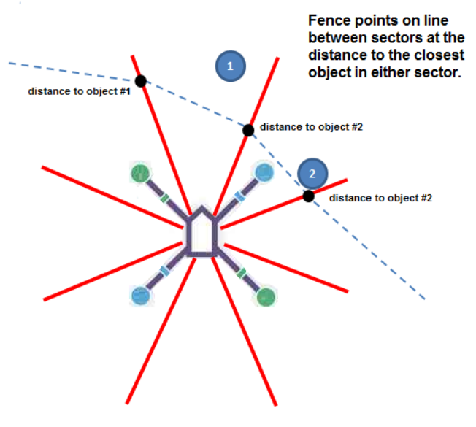
Distances from different Base Stations

Slide 5
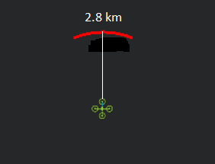
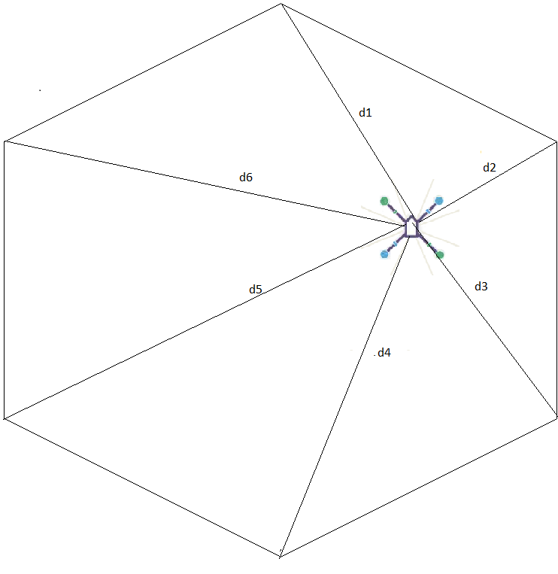
Nearest Base-Station
RF Wave Transmission:-
Time= t
Speed= c (c= 3*10^8 m/s)
Distance,D =2d
D= c*t
2d= (3*10^8)*t
d= (1.5*10^8)*t

Slide 6
Approach 1
Check Signal Strength
LL<Sig<UL
Sig<=LL
Or
Sig>=UL
Check PW
(Throttle)
Sig=LL
PW=1ms
Sec Ckt ON
Take Feedback
Switch OFF the transmitter

Slide 7
Check Signal Strength
LL<Sig<UL
Sig<=LL
Or
Sig>=UL
Approach 2
Check PW
(Throttle)
Sig=LL
Gradual dec.
Instantaneous dec.
Sec Ckt ON
Sig=LL
Sig=LL
Safe landing
Sec Ckt ON

Slide 8
To tackle the above mentioned problems we have prototyped End-to-end encrypted, independent circuit based Radio pulsating system.
1- The strength of the signal would be read as analog values by the microcontroller on the unit and the secondary circuit will be activated as soon as the value falls below a predefined parameter.
2. At the time of hijack/hack, the IP address of controlling server will be changed. Primary circuit will shut down and independent secondary circuit will take charge having no GPS or Wi-Fi connectivity.
3. The secondary circuit will start to initiate the radio pulses which will reflect back from the nearest base station.
4. These pulses will be generated randomly and the frequency of their generation would be inversely proportional to the return time of the previous pulse.

Slide 9
5. The UAV will detect the nearest base station by referring to the return time of the pulse and continue to move in the assessed direction.
6. The pulsating system will work till the UAV has reached the nearest base station, i.e., the return time of the pulse changes to 0.
7. The unit can then be recovered by physically going to the base station or reactivating the primary circuit.

Slide 10
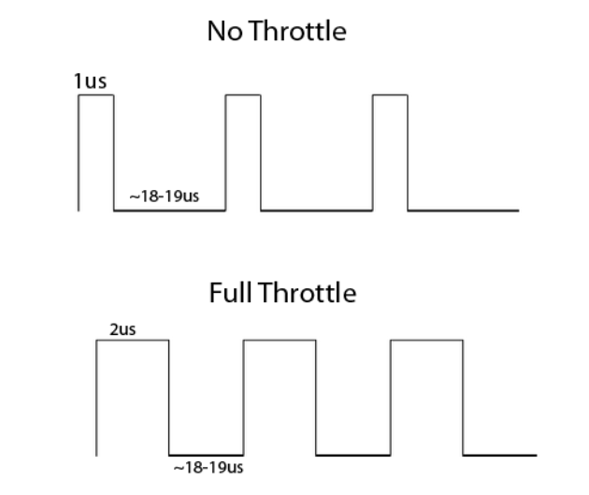
Throttle Pulse Width
1ms
The pulse is between 1000us and 2000us long with a 18000us to 19000us pause before the next – so a throttle of 0 would produce a pulse of 1000us and full throttle would be 2000us.
2ms

Slide 11

Signal Strength:-

Slide 12
Ultrasonic Detector:-

Slide 13
We have implemented a dual circuit system in the drone.
The solution of ours include-
The drone will return home if the signal is lost or in case if it is hacked or hijacked.
There two circuits in the drone- Primary and Secondary.
The Primary Circuit consists of a GPS module used for navigation, Opamp to be used as a comparator for desired and the actual signal, Amplifier used for signal strengthening.
Secondary circuit consisting of a Radio Wave Transmitter and Receiver and Motion Sensors.
The signal for the drone will have a predefined range. It will be amplified if it falls below a certain value. If there is a further decrease in its strength, in that case, drone will return back home.
The data in the drone will have end to end encryption (cryptography) to avoid the possibilities of hacking.
The drone distinguishes whether it has lost the signal or it has been landed by the user by checking the status of the throttle when the transmitter shuts down. The secondary circuit will come into play when the transmitter has shut down but the throttle is not zero.

Slide 14
If the signal is hacked or hijacked, such that its IP address gets changed due to change in the controlling server, then the primary circuit will be deactivated and the control will be done by the secondary circuit only.
If the drone is hijacked by some external means such that it's controlling server remains same, then the on-board motion sensors will detect the deviation of drone from the desired path and primary circuit will cut off.
The radio wave transmitter in the secondary circuit will generate the R.F. pulse to be reflected by the nearby base stations, the drone will head towards the base station having the smallest return time.
The frequency of generation of this pulse would be inversely proportional to the distance from the base station, which can be estimated by noting the return time of the previous pulse, i.e., the pulses will be generated more rapidly as the drone approaches the base station.

Slide 15
This distance dependency of the pulse generation serves a triple point purpose of randomising the pulse receiving operation thus eliminating the possibility of external interference, increasing the battery life of the drone and also increasing the precision by which the base station is located.
To avoid obstacle during the return, the on-board motion sensors (ultrasonic) will be used as Inertial Navigation System.
The frequency of generation of this pulse would be inversely proportional to the distance from the base station, which can be estimated by noting the return time of the previous pulse, i.e., the pulses will be generated more rapidly as the drone approaches the base station.
This distance dependency of the pulse generation serves a triple point purpose of randomising the pulse receiving operation thus eliminating the possibility of external interference, increasing the battery life of the drone and also increasing the precision by which the base station is located.
To avoid obstacle during the return, the on-board motion sensors (ultrasonic) will be used as Inertial Navigation System.

